Slide 1
Huffman Coding
Huffman coding is a compression technique. It reduces the size of message(data).
We store data in a file, so data can be compressed to reduce the size of file.
Compressed data when sent, reduces the cost of transmission.
Fixed size encoding and variable size encoding
Notes:
Huffman coding algorithm is widely used in various applications where efficient data compression is necessary. Some of the key applications of Huffman coding include:
Data Compression: Huffman coding is extensively used in file compression algorithms such as ZIP, JPEG, MP3, and PNG. It helps in reducing the size of files by assigning shorter codes to more frequent characters or symbols and longer codes to less frequent ones, thereby achieving compression without losing data.
Network Transmission: In data communication and network protocols, Huffman coding aids in reducing the amount of data to be transmitted over the network. This is crucial for efficient bandwidth utilization and faster transmission speeds, especially in scenarios like internet browsing and multimedia streaming.
Image Compression: Within image compression formats like JPEG and PNG, Huffman coding is employed to reduce the file size of images. It efficiently represents color and pixel information by assigning shorter codes to frequently occurring patterns in images.
Text Compression: Huffman coding finds applications in text compression techniques, making text files smaller in size. This is utilized in various applications, including document storage, email attachments, and text-based communications.
File Archiving: Huffman coding is an integral part of many archiving formats like TAR, GZIP, and RAR. It's used to compress multiple files into a single archive file, reducing the overall storage space required.
Embedded Systems: In resource-constrained environments like embedded systems (e.g., in IoT devices, microcontrollers), Huffman coding is used to compress data, allowing more efficient use of limited memory and storage capacities.
Speech and Audio Compression: Huffman coding plays a role in audio compression formats like MP3 and AAC, enabling the reduction of audio file sizes without significant loss of quality. This is essential for various applications such as music streaming and storage.
DNA Sequencing: In bioinformatics, Huffman coding can be applied to compress and represent DNA sequences efficiently, facilitating storage and analysis of large genomic data sets.

Slide 2
Message---> BCCABBDDAECCBBADDCCE
Length=20 characters
Electronic devices—use ASCII codes for encoding characters.
ASCII codes are 8 bit codes. Total size of message= 20x8= 160 bits
Simple message sent without encoding.
A-------> 65------> 01000001
B--------66---------01000010
C---------67
D--------68
E---------69
8 bit code are used for 128 characters.

Slide 3
Fixed size codes
Can we use our own codes instead of ASCII codes.
If I use only five capital alphabets in a message, not all characters from keyboard.
Do I need 8 bit codes for representing 5 alphabets? No
Few bits are sufficient, and we can use our own codes with less amount of bits.
Message---> BCCABBDDAECCBBADDCCE
I will use my own 3 bit code for encoding the above message, and it will reduce the size of the message.
Total size of message after encoding= 20 x 3= 60 bits
Character | Count/Frequency | Codes
A | 3 | 000
B | 5 | 001
C | 6 | 010
D | 4 | 011
E | 2 | 100
8 bits---128 characters
For only five characters: 3 bits are sufficient.
1 bit= 2 combinations/characters
2 bits= 2²= 4 characters
3 bits= 2³= 8 characters

Slide 4
Encoded message plus Chart of codes (Table of codes)-helps receiver to decode the message.
5 alphabets (characters) in table—should be in original form (ASCII codes) or 8 bit codes.
For characters/symbols in Tables: 5 x8bits=40
For 3 bit Codes in Tables: 5x3 =15
Total size of Table= 55
Total size of message along with the table= encoded message + Table size= 60 + 55= 115 bits.
About 35-40 % reduction in size of message from 160 bits to 115, when used fixed sized codes.

Slide 5
Huffman coding
Huffman encoding does not assign fixed size codes to characters.
Some characters may appear more times while some appear less times, if we assign small size codes to frequent characters, then size of entire message will be reduced.
Huffman coding follows optimal merge pattern.
Huffman provides an approach for generating variable size codes. He says that alphabets should be arranged in increasing order of their frequencies/counts.
Optimal merge pattern tree, Actually, we followed optimal merge pattern that is a greedy approach, which selects a pair of two smallest numbers.

Slide 6
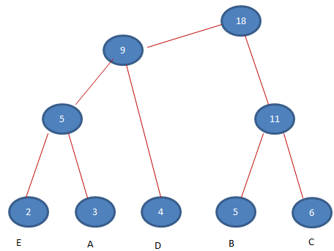
Huffman coding
Message---> BCCABBDDAECCBBADDCCE
Character | Count/Frequency | Codes
A | 3
B | 5
C | 6
D | 4
E | 2
20
This tree will help us to define the codes. Mark the left edges with 0 and right edges with 1. For each alphabet, follow a path from root onwards towards that alphabet

Slide 7
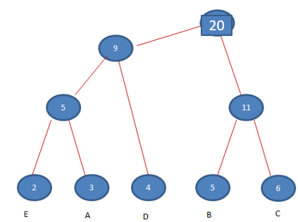
Message---> BCCABBDDAECCBBADDCCE
Size of Message = 45 bits
Decoding by receiver end can only be done when the encoded message is sent along with the chart of codes(Table of codes) or codes tree.
Size of characters= 5x8= 40 bits, size of codes=12
Size of table/tree= size of characters + size of codes= 40 +12=52 bits
Total size= Message size + Table/tree size= 45 + 52=97 bits
Size is still reduced from fixed size codes
Character | Count/Frequency | Variable size Codes | Size of Message
A | 3 | 001 | 3x3=9
B | 5 | 10 | 5x2=10
C | 6 | 11 | 6X2=12
D | 4 | 01 | 4X2=8
E | 2 | 000 | 2X3=6
 |  |  | 45 bits

Slide 8
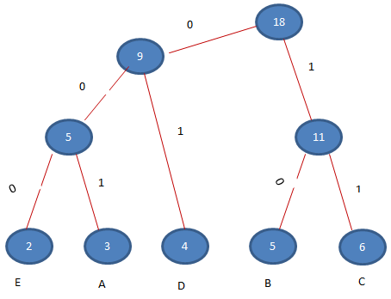
Determine size of message using the tree
Use this formula: ∑ di Fi = 3x2 + 3 x3 + 2 x4 + 2 x 5 + 2 x6= 45

Slide 9
Decoding by Receiver
Message---> B C C A B B D D A ECCBBADDCCE
10 11 11 001 10 10 01 01
Decoding a message: BCCA….
Bit stream------original message
The receiver can convert the original message into ascii codes and use in machine

Slide 10
